Slide 1
Chapter 7: Vertical Integration & Outsourcing

Slide 2
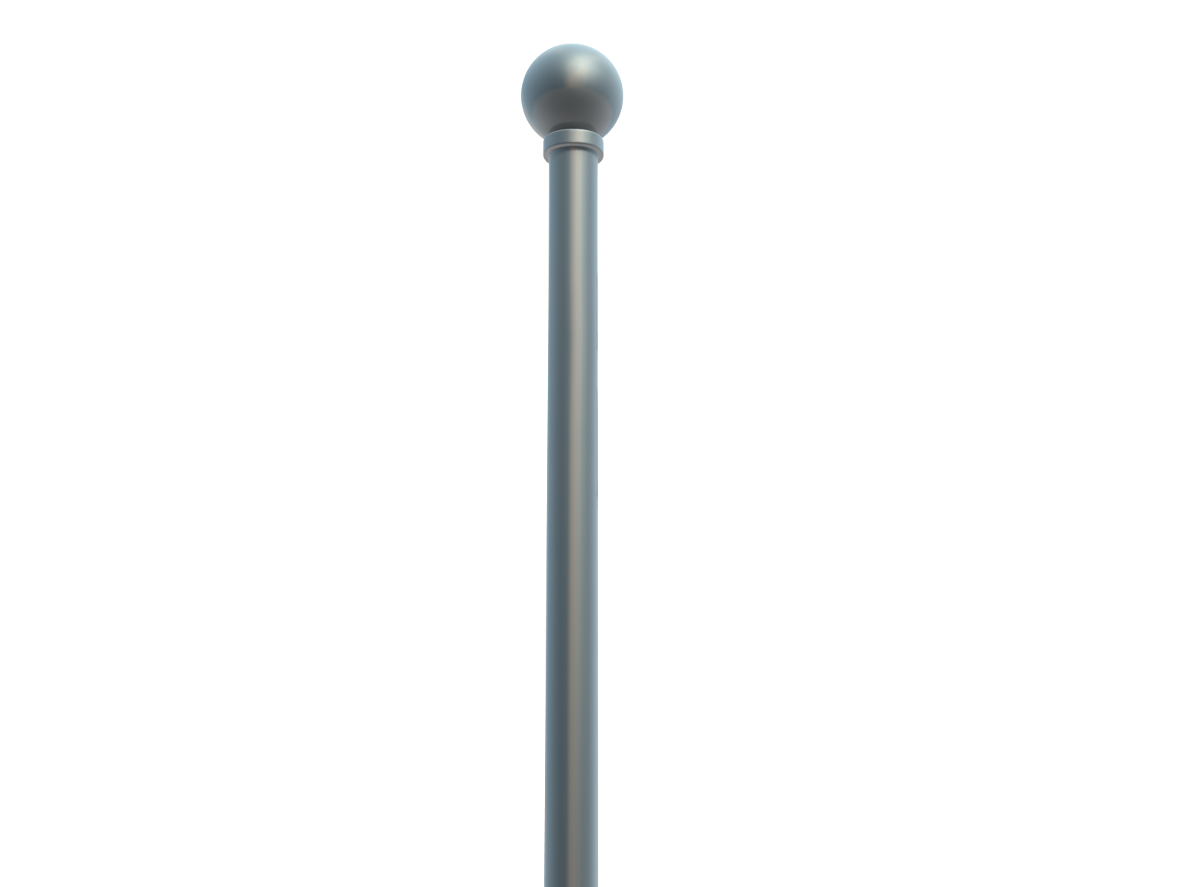
Chapter 7
& Outsourcing
Vertical Integration

Slide 3
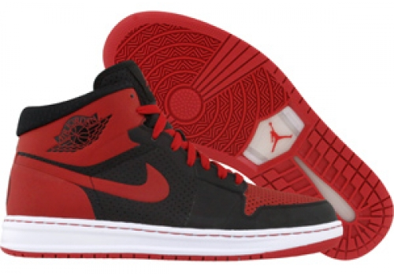
Nike
Value Proposition
Differentiation through shoe (product) design and effective marketing/brand

Slide 4
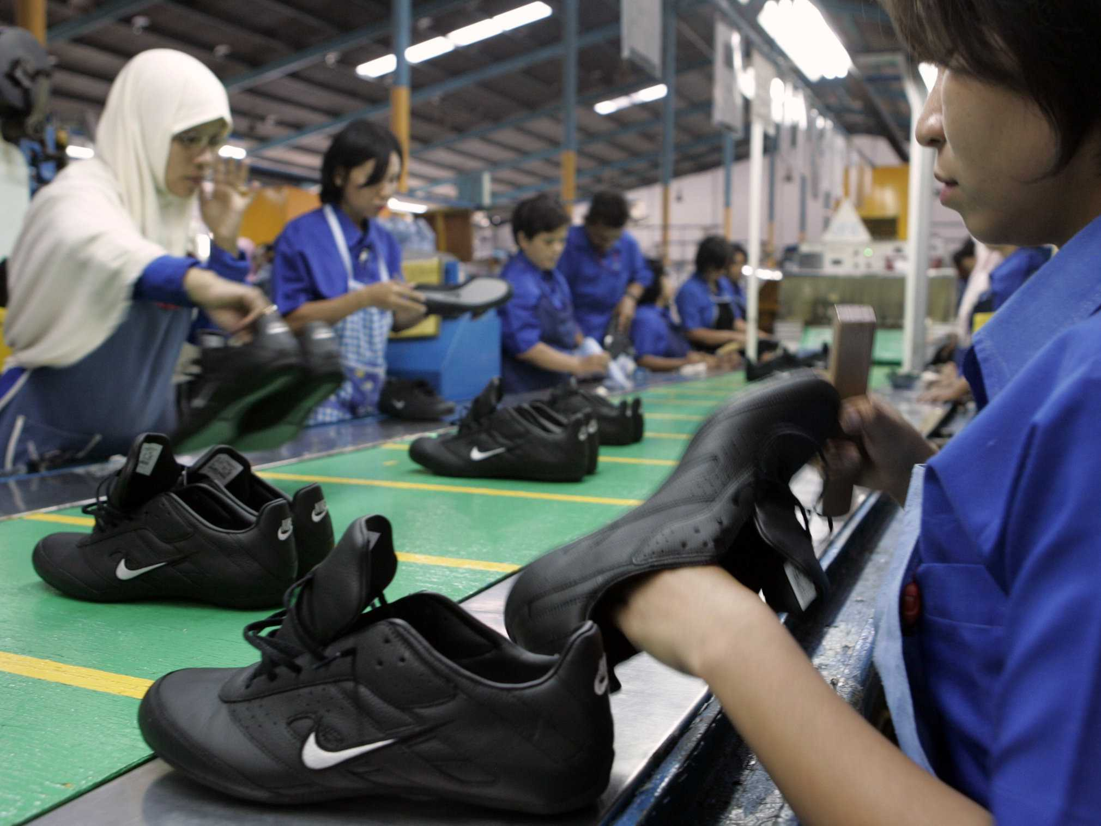
How Nike Delivers Unique Value
Core Capabilities
Outsourcing Strategy
Nike’s core capabilities are shoe design and marketing
Nike’s outsourcing strategy allowed it to plow additional money into building those core capabilities

Slide 5
Theories of Vertical Integration
MAKE
BUY

Slide 6
Make VS. Buy
Different Companies Can Take Different Paths
Notes:
ASUSTek launched Eee PC in Taiwan at $340 and sold all units produced in the first day; stock price increased by 5 percent in one day.
Brand
Product Design
Supply Chain & Logistics
Supply Chain & Logistics
Computer Assembly
Computer Assembly
Mother Boards
Mother Boards
Simple Circuit Boards

Slide 7
Advantages of Outsourcing
Flexibility: Allows a firm to flexibly move to new suppliers that offer lower costs or better technology
Focus: Keeps the firm focused on a narrower set of core competencies that:
Allows it to specialize, thereby increasing its expertise and its scale/experience in those activities.
Minimizes capital investment by only investing in a few core activities.

Slide 8
Vertical Integration
Outsourcing isn’t always the answer
Who Let
Intel Inside?

Slide 9
Dangers of Outsourcing
Loss of Control/Power
May give an outside supplier undue power or control if the outsourced activity is critical to success
Loss of Capabilities
May set in motion the loss of capabilities that may be important for the future—and create a future competitor

Slide 10
3 Reasons for Vertical Integration
CAPABILITIES
COORDINATION
CONTROL
Conduct the activity internally when the firm has or can develop better capabilities to perform it than other firms
Conduct the activity internally when effective coordination and tight integration of the activity with other firm activities provides product performance advantages (differentiation)
Conduct the activity internally to control scarce inputs or to control co-specialized asset investments
e.g., Alcoa integrates back into bauxite to secure scarce and critical raw material for aluminum)
(e.g., oil refinery controlling the pipeline)

Slide 11
Make or Buy?
You have to decide whether to make or buy a component (part) that is an input for a product that you sell for $49.95. Your analysis shows that based upon the estimated volume of parts you will require, your variable costs per unit will be $.50 and given estimated volumes, your fixed (plant and equipment) cost per unit is $.48 per unit. A quick bid in the market suggests that you can currently buy the same part from two suppliers for $1.00 (another supplier bid $1.01).
You Should:
A. Make the part and capture the profits
B. Buy the part on the market
C. Make some parts and buy some parts to keep leverage over suppliers
D. None of the above

Slide 12
This powerpoint preview has been provided to you courtesy of the co-authors of Strategic Management. Access to the full powerpoint deck on this topic is only available for those who adopt our textbook after visiting Wiley at:
http://www.wiley.com/WileyCDA/WileyTitle/productCd-1119411696.html
After adopting our text please contact one of the authors via email for access to the full powerpoint decks:
Jeff Dyer: jdyer@byu.edu
Paul Godfrey: Paul_Godfrey@byu.edu
Robert Jensen: RobertJensen@byu.edu
David Bryce: dbryce@byu.edu

